Slide 1
City-Scale Location Recognition
Berkay inan

Slide 2
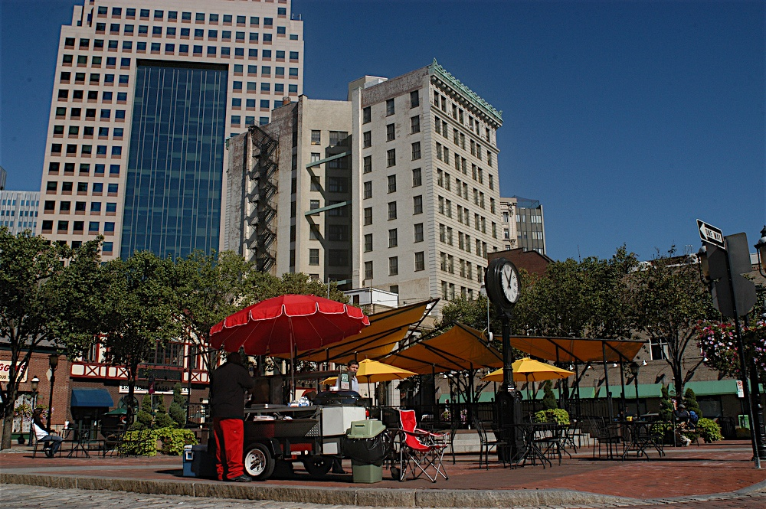
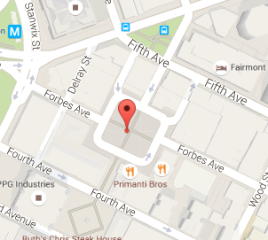
Introduction
Project based on
G. Schindler, M. Brown and R. Szeliski, "City-Scale Location Recognition," 2007 IEEE Conference on Computer Vision and Pattern Recognition
Objective
Estimate the location of a photograph by searching a large database

Slide 3
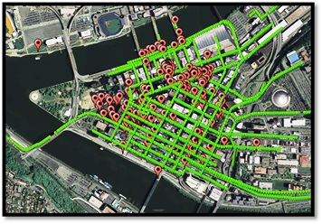
Training Dataset
Google Street View Dataset
Amir Roshan Zamir and Mubarak Shah, "Image Geo-localization Based on Multiple Nearest Neighbor Feature Matching using Generalized Graphs", IEEE Transactions on Pattern Analysis and Machine Intelligence (TPAMI)
Pittsburgh, Florida, Manhattan
Images from 10343 locations alongside with their latitude and longitude
There are 6 images at each location
62058 images

Slide 4
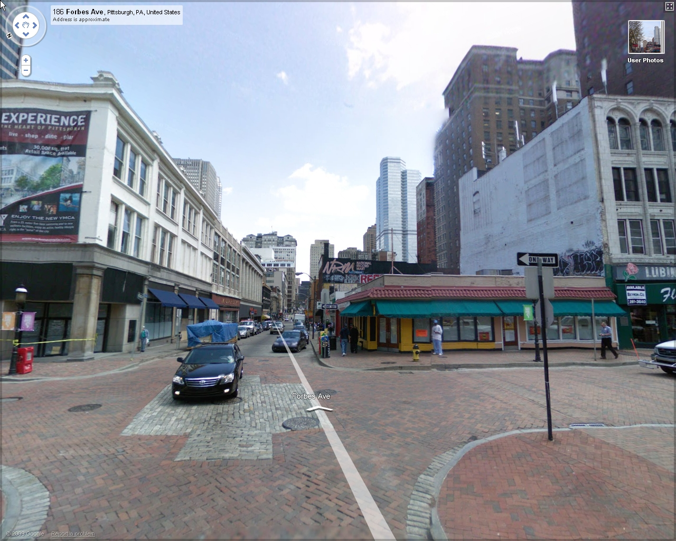
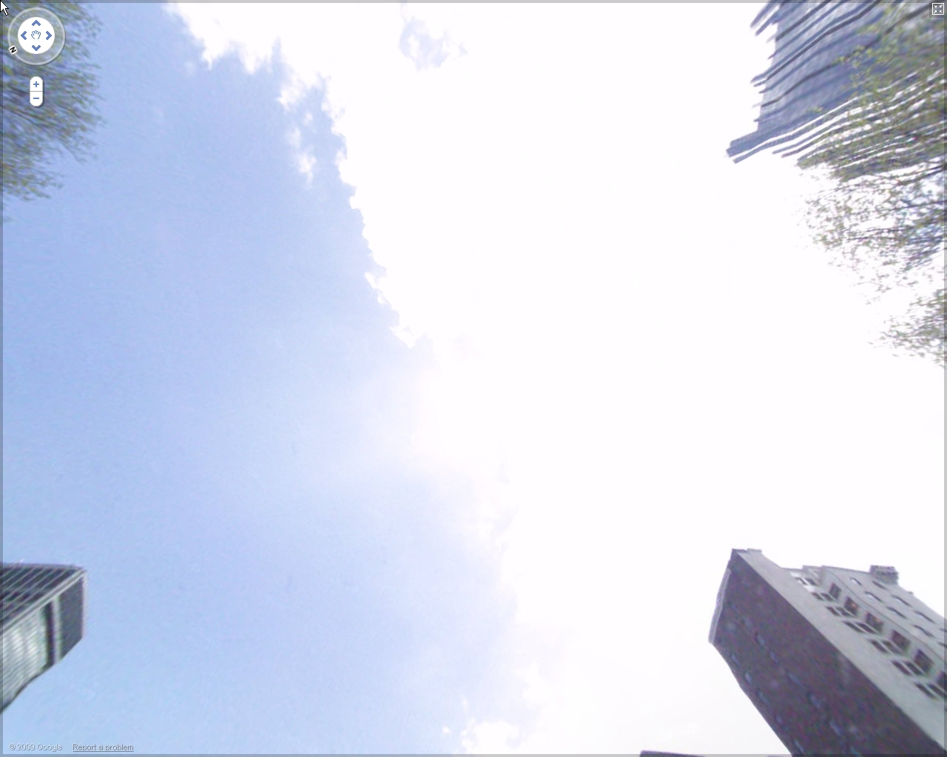
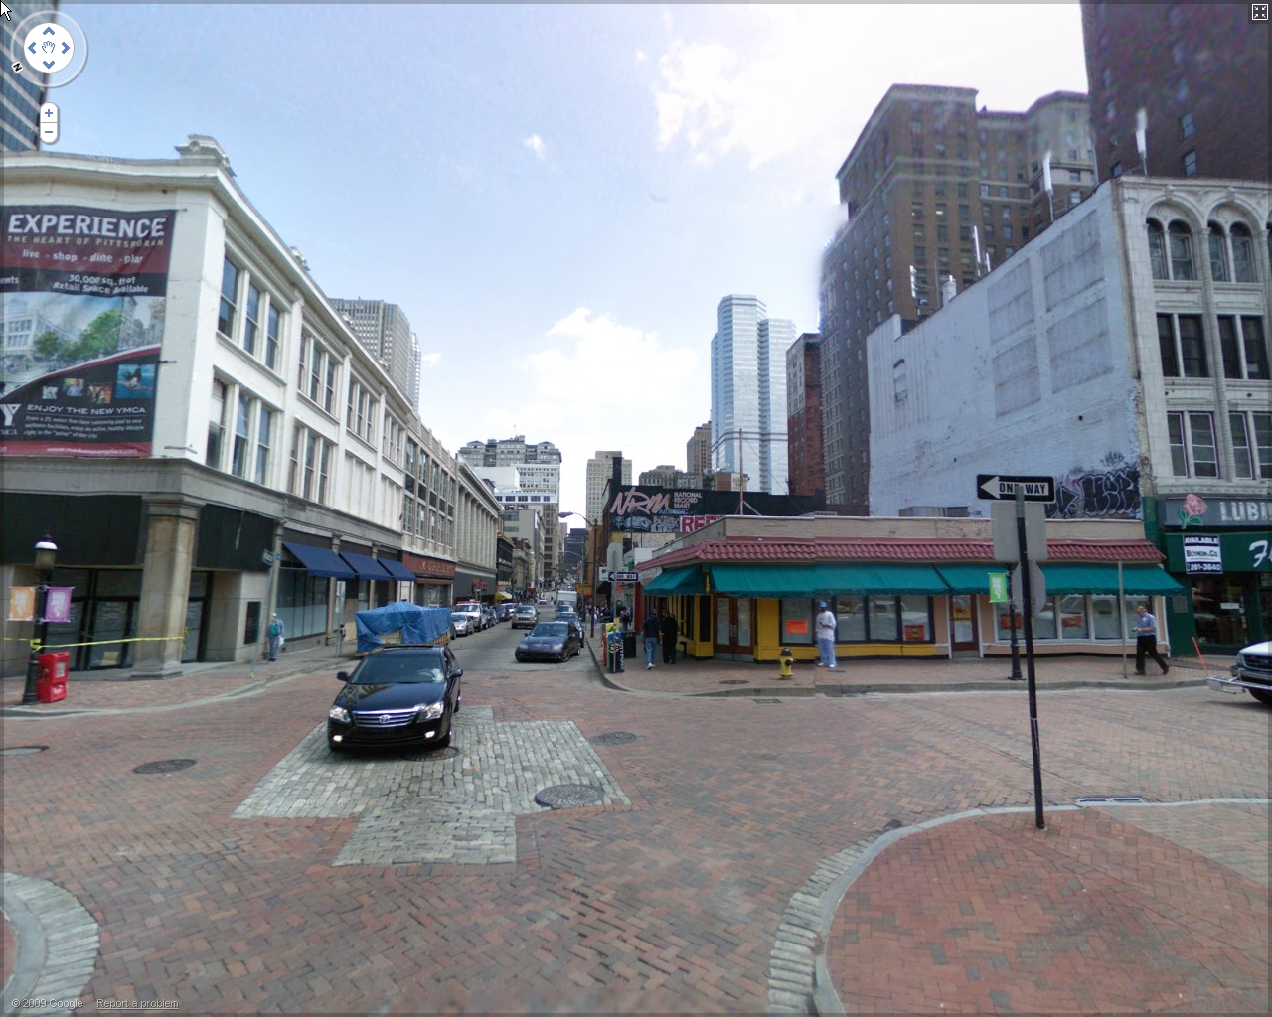
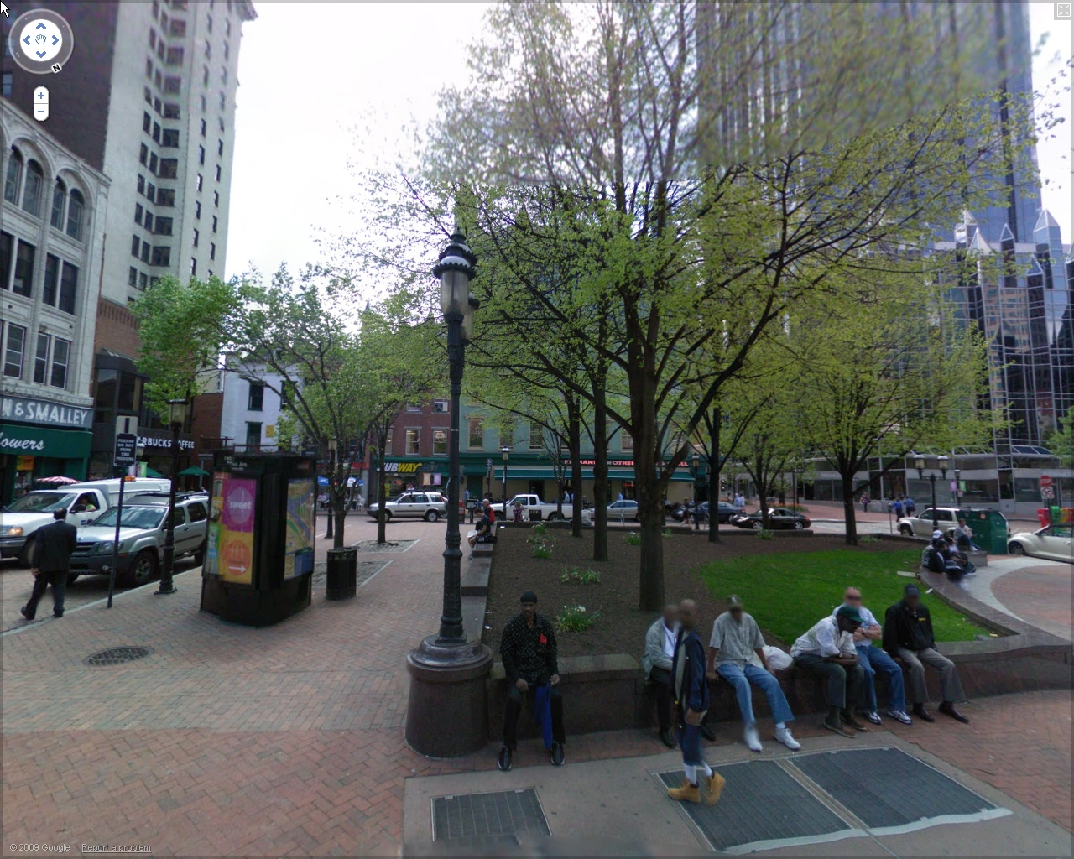
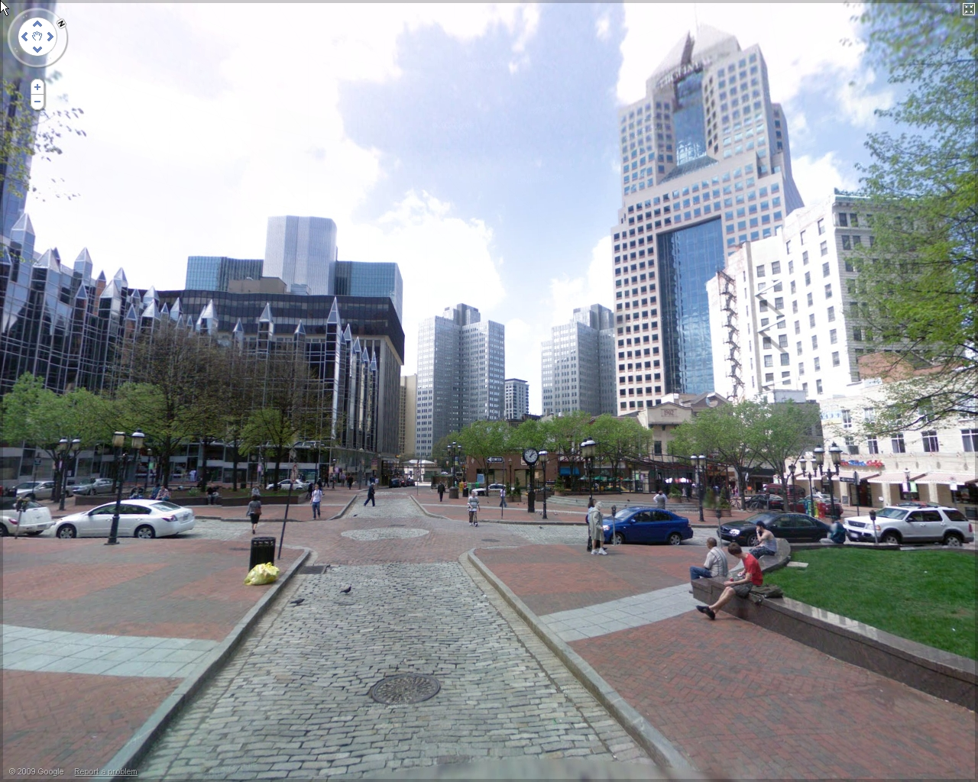
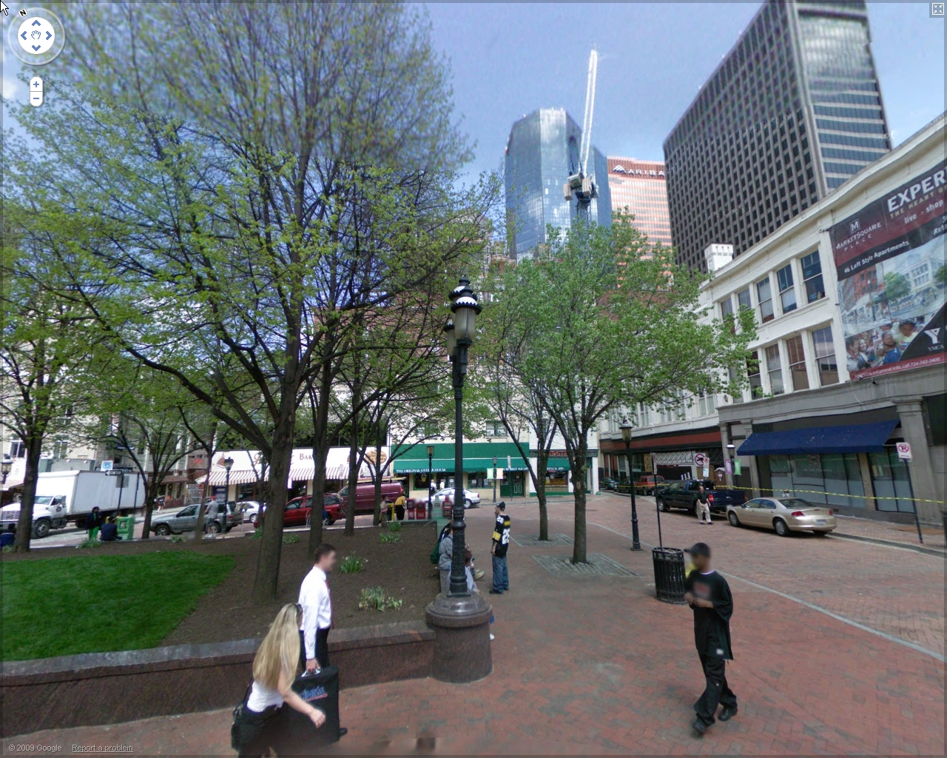
Training Dataset

Slide 5

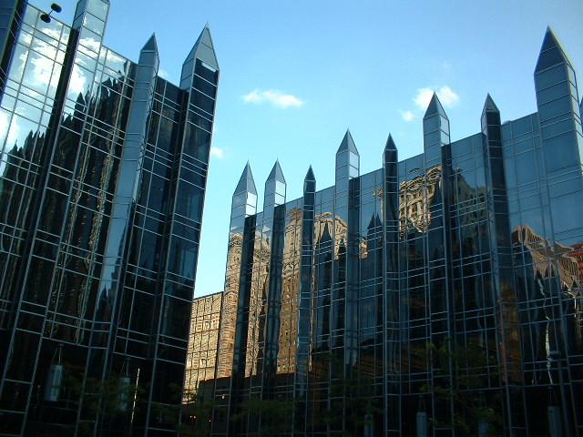
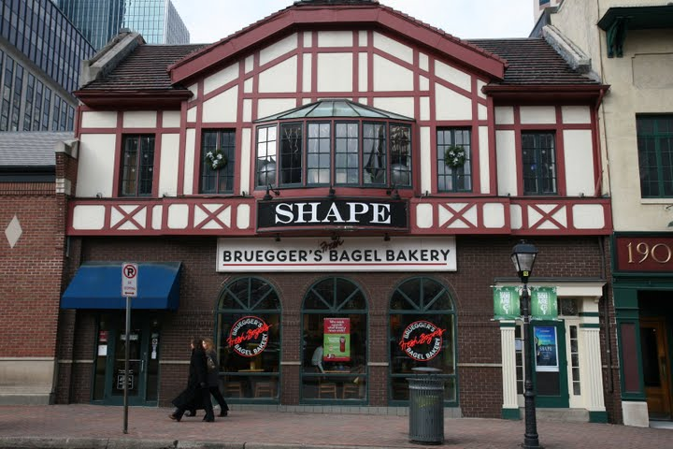
Test Set
639 images taken with consumer digital cameras
460 image has ground truth information

Slide 6
Standard Approach to Image Matching
Standard approach to image matching
Extract rotation invariant features from each database image
Build kd-tree of feature space
Match each feature in query image to database features
Difficulities with large databases
Memory
Search time

Slide 7
Feature Matching Problem
Database used in the research paper
30000 images
100 million features
Google Street View Dataset
51000 images
255 million features
Too many features to store and compare exhaustively

Slide 8
Training Block Diagram

Slide 9
Query Block Diagram

Slide 10
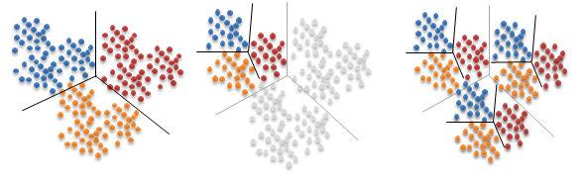

Vocabulary Trees
Hierarchical K-means clustering
Used to map features to visual words
At each level apply K-means clustering to each cluster
Tree structure with $K^{L}$ leaf nodes with branching factor K

Slide 11

Vocabulary Trees
Two methods of building
Agglomerative (Bottom up)
Divisive (Top down)
Advantages
Search time : $O(KL)$
Disadvantages
Slower than K-means to construct
Heuristic search

Slide 12
Best Bin First

Slide 13
Best Bin First

Slide 14
Best Bin First
Depth
Level: 1
Depth Level : L

Slide 15
Greedy N-Best Paths Search
N=2

Slide 16
Greedy N-Best Paths Search
N=2

Slide 17
Greedy N-Best Paths Search

Slide 18
Vocabulary Tree Search
Best Bin First
K comparisons at each level
To change number of comparisons, a new tree must be constructed
Greedy N-Best Paths Search
KN comparisons at each level
Number of comparisons can be change on-the-fly
Allows trade-off for complexity vs search time

Slide 19
Informative Features
Clustering
NP-Hard
Computation time grows with high polynomials of N
Too many features
Cannot use all of the features
Choose the features that provide the most information

Slide 20
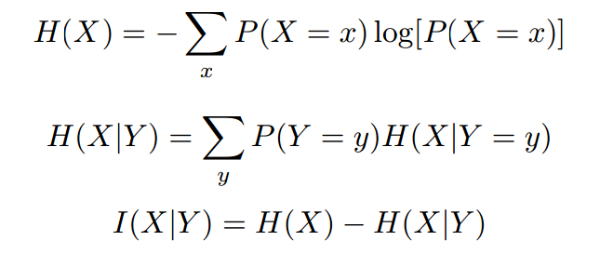
Information Gain
Ideally ,for each location
Find words with that only appears in one location
Quantitively, the information gain can be expressed with information theory.

Slide 21





Information Gain
$I\left(W_{j} | L_{i}\right)$ : information gain for word j at location i
Problem of choosing informative features
argmax $I\left(W_{j} | L_{i}\right)=\text{argmax} H\left(L_{i}\right)−H\left(L_{i} | W_{j}\right)$
$\{W_{j}$}
$\{W_{j}$}
$$=\text{argmin} H\left(L_{i} | W_{j}\right)$$
$\{W_{j}$}

Slide 22
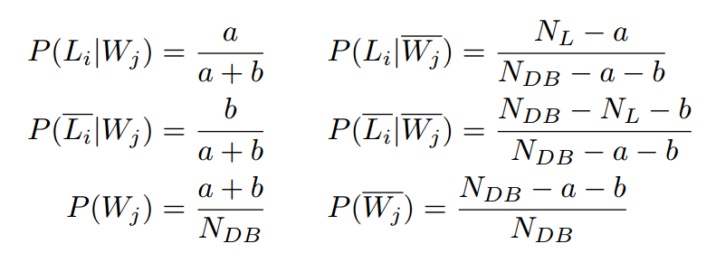


Information Gain
a = $N_{W_{j}L_{i}}$
b = $N_{\overline{W_{j}}L_{i}}$

Slide 23
Feature Selection
For each image in database
For each feature
Calculate the information gain of corresponding word
Choose most informative features as representative of this image

Slide 24
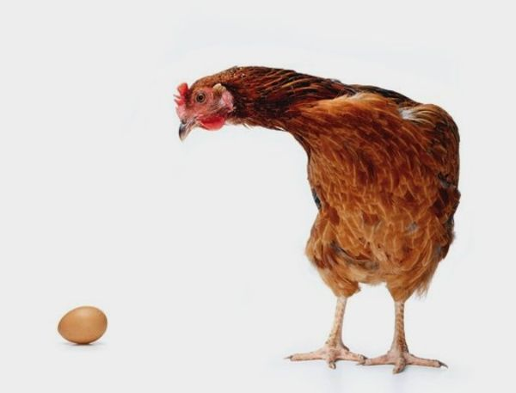
Chicken and Egg
We need visual words to calculate information gain
We need information gain to build the vocabulary of words

Slide 25
Modified Training Block Diagram

Slide 26
Modified Training Block Diagram

Slide 27
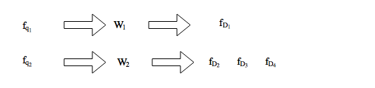
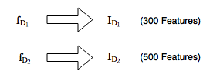
Voting Scheme
To match query image
Each query feature casts votes for database images
Feature that maps onto a ‘crowded’ word
Lesser weight
Feature that votes for an image that has too many features
Lesser weight

Slide 28
Voting Scheme
Averaging

Slide 29
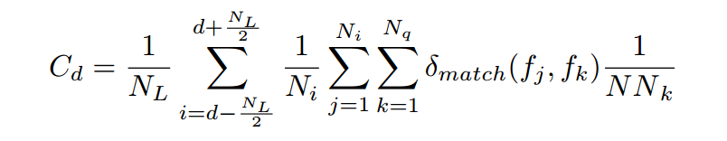

Voting Scheme
$f_{k}:Query Feature k$
$f_{j}:Database Feature j$
$N_{i}:Database image i$
$N_{L}:Number of nearby locations$

Slide 30
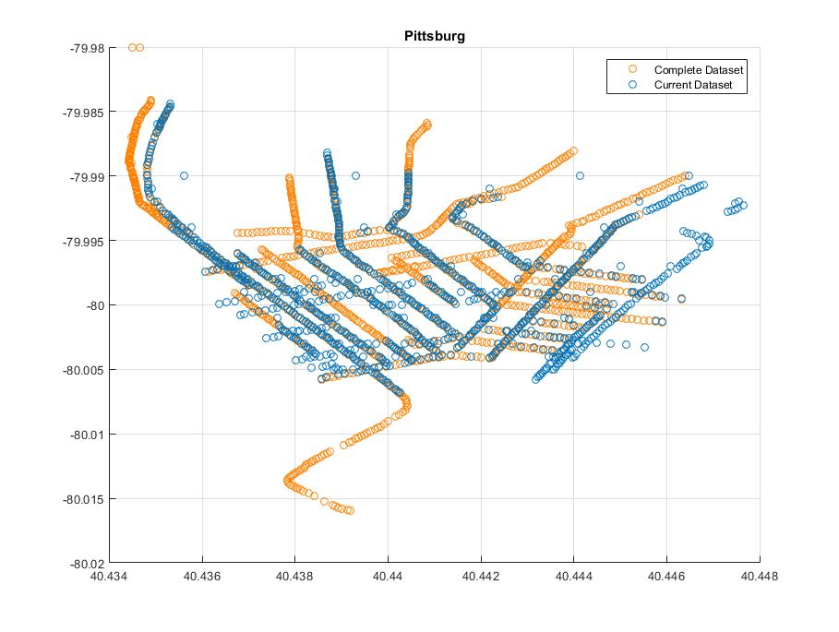
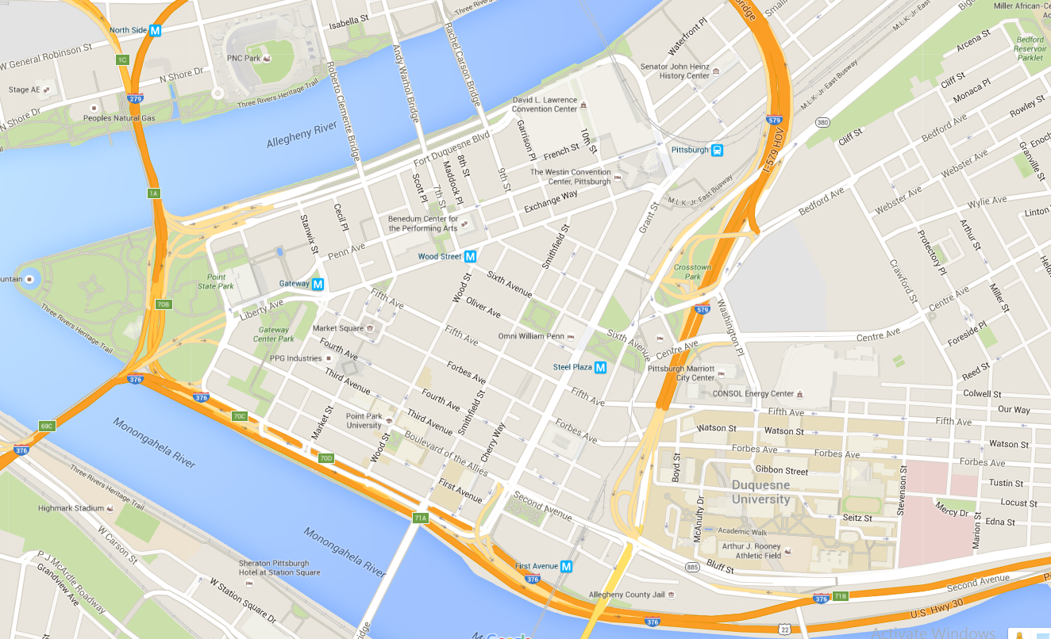
Results
Out of 10343 locations
1000 location used
Each training subset had 100 locations (500 images)

Slide 31
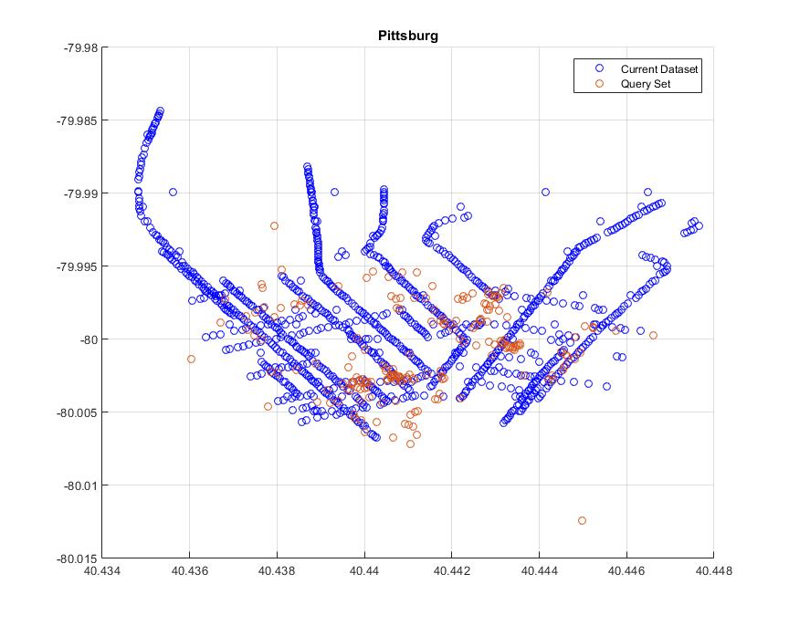
Results
1.1 km x 1.4 km

Slide 32
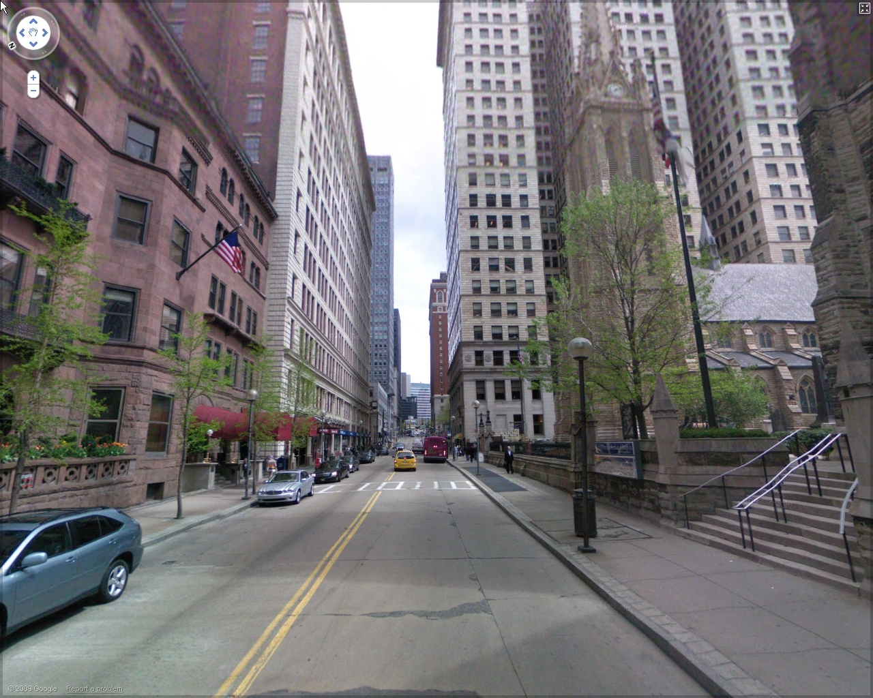
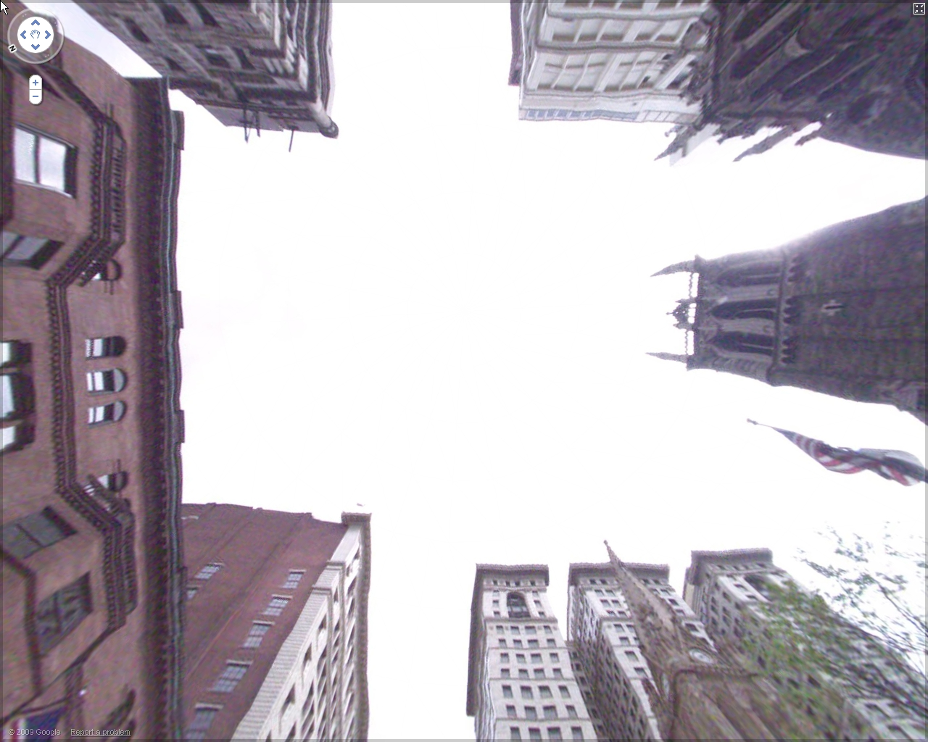
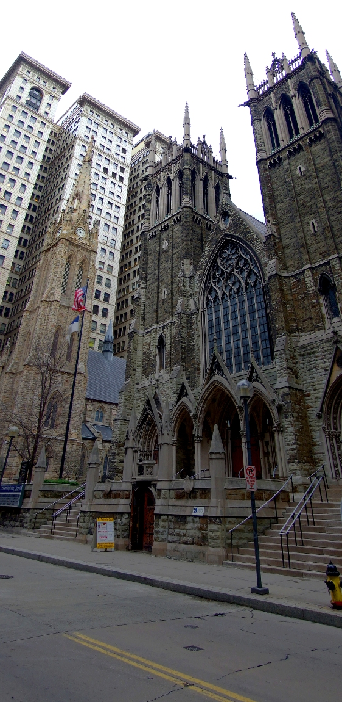
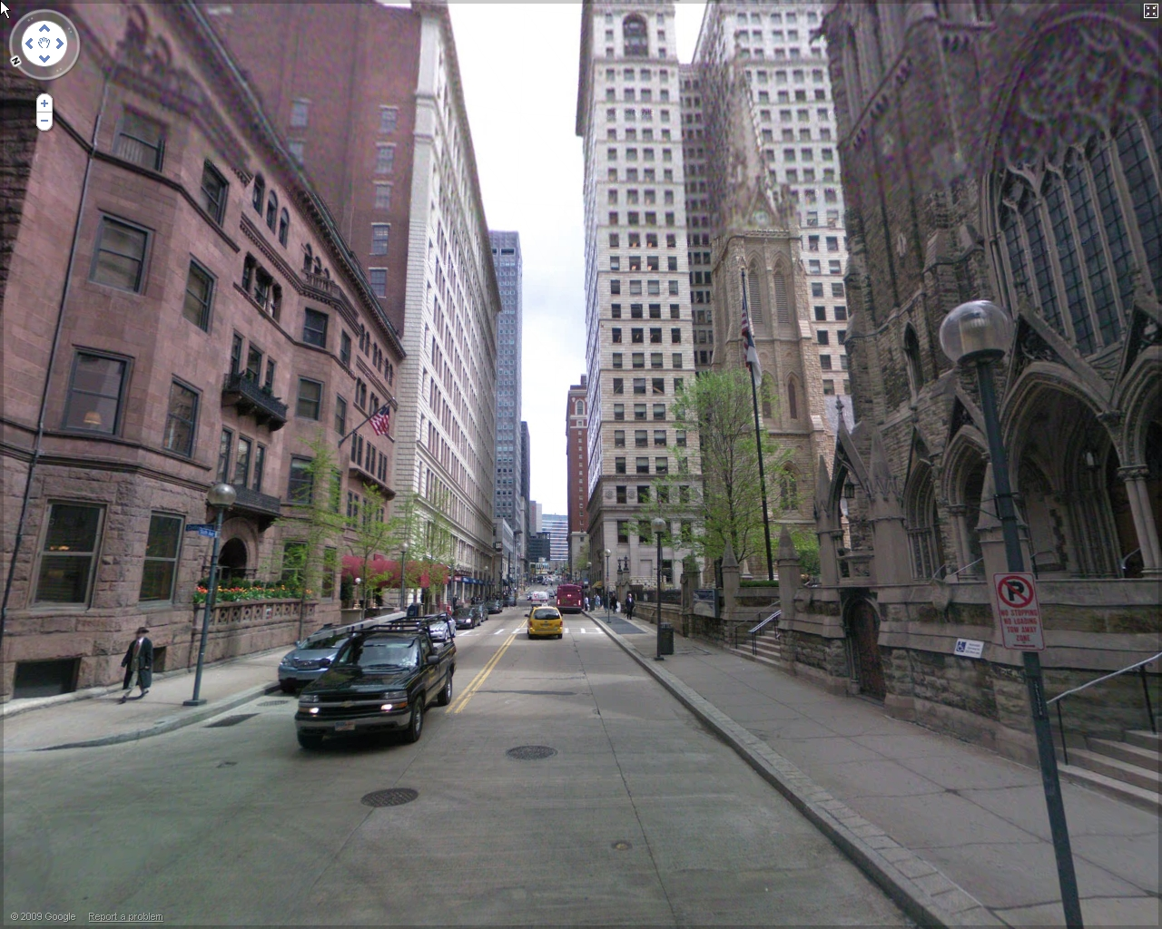
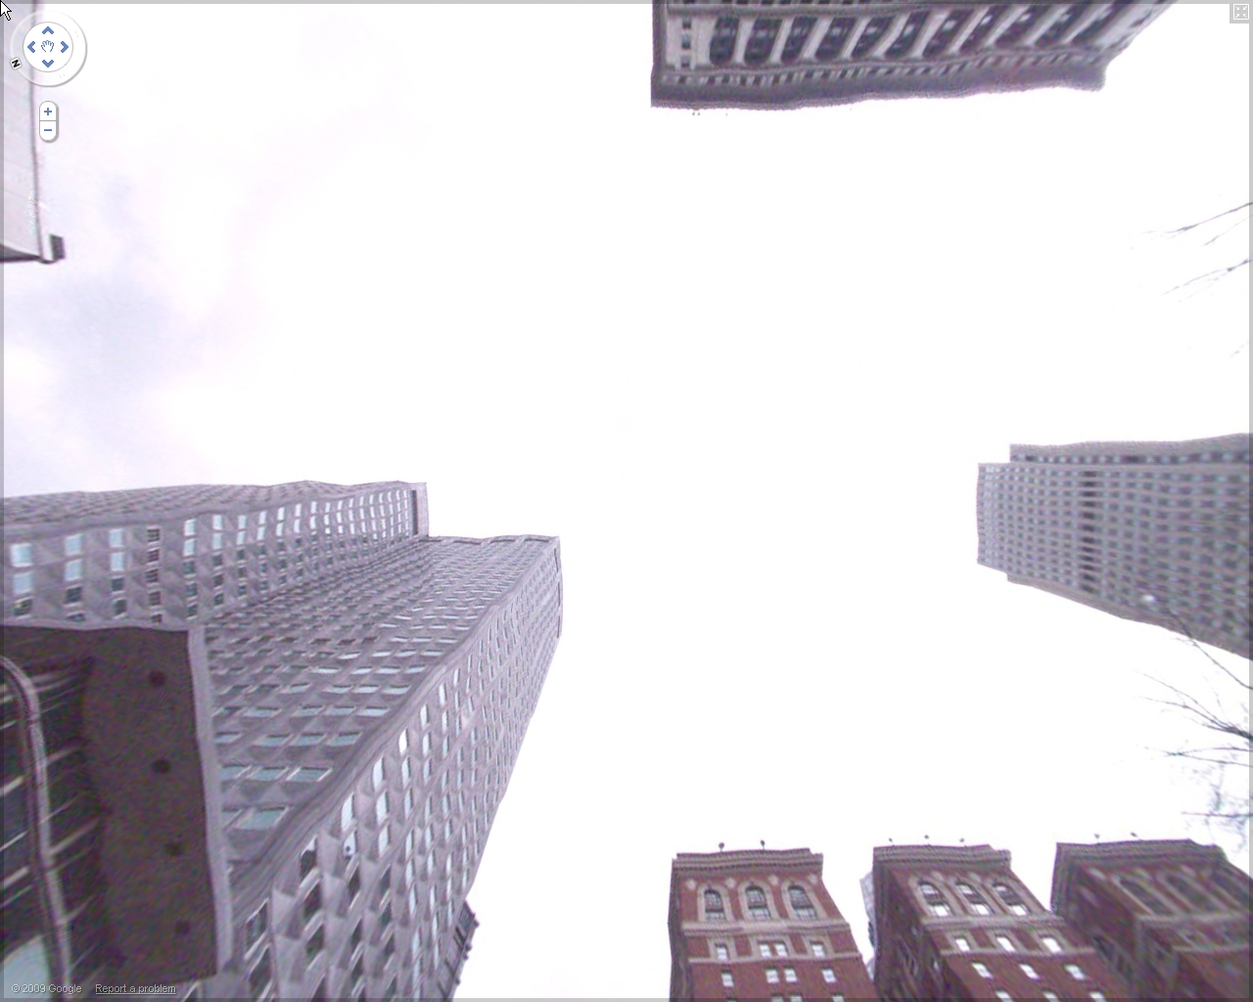
Sample Matches
1
3
15 m
25 m
2
4
Query Image
6 m
176 m

Slide 33
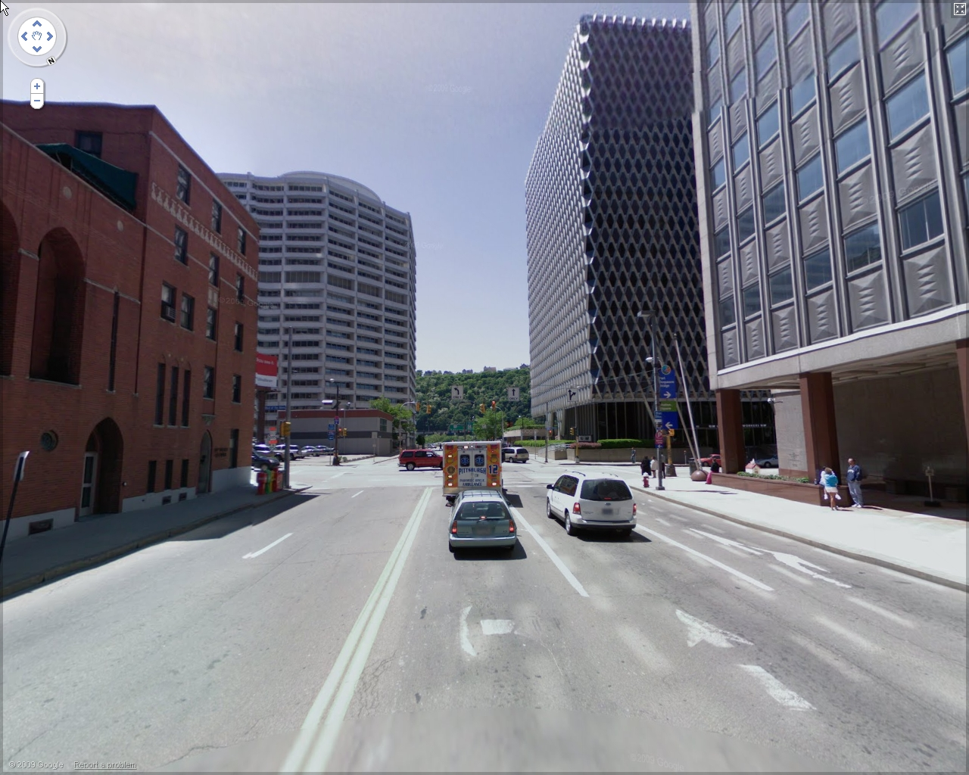
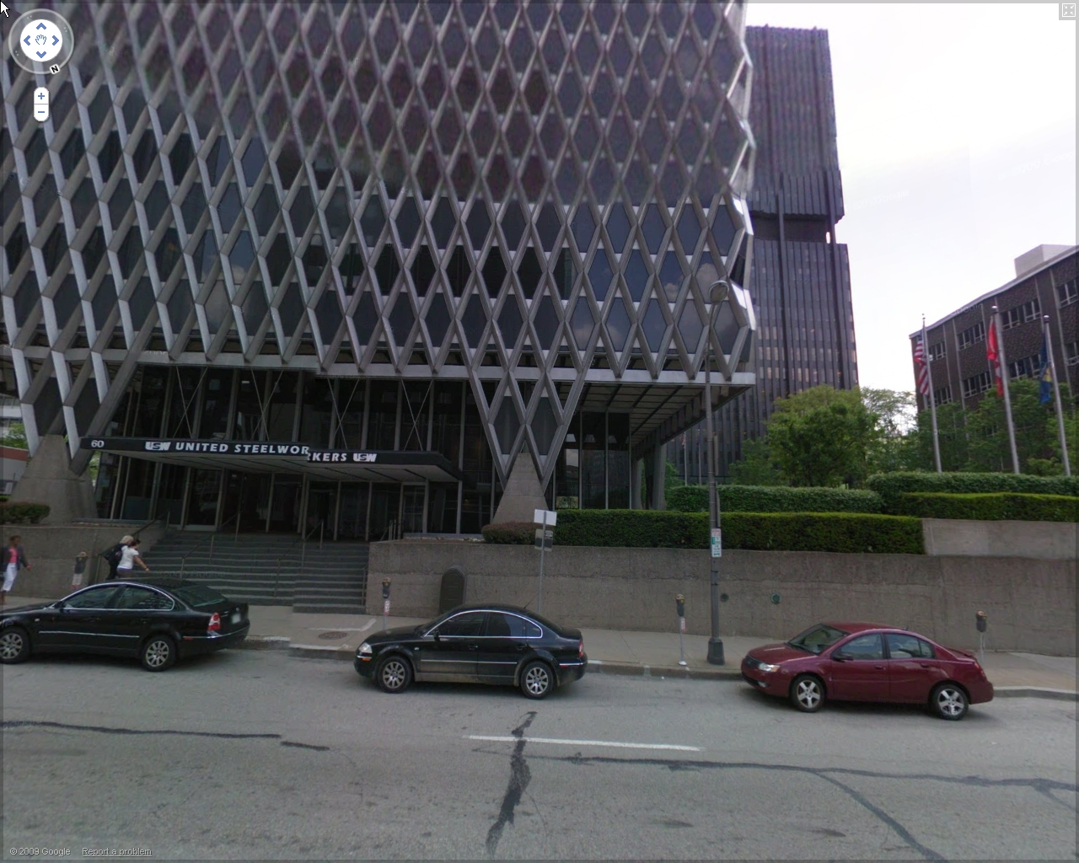
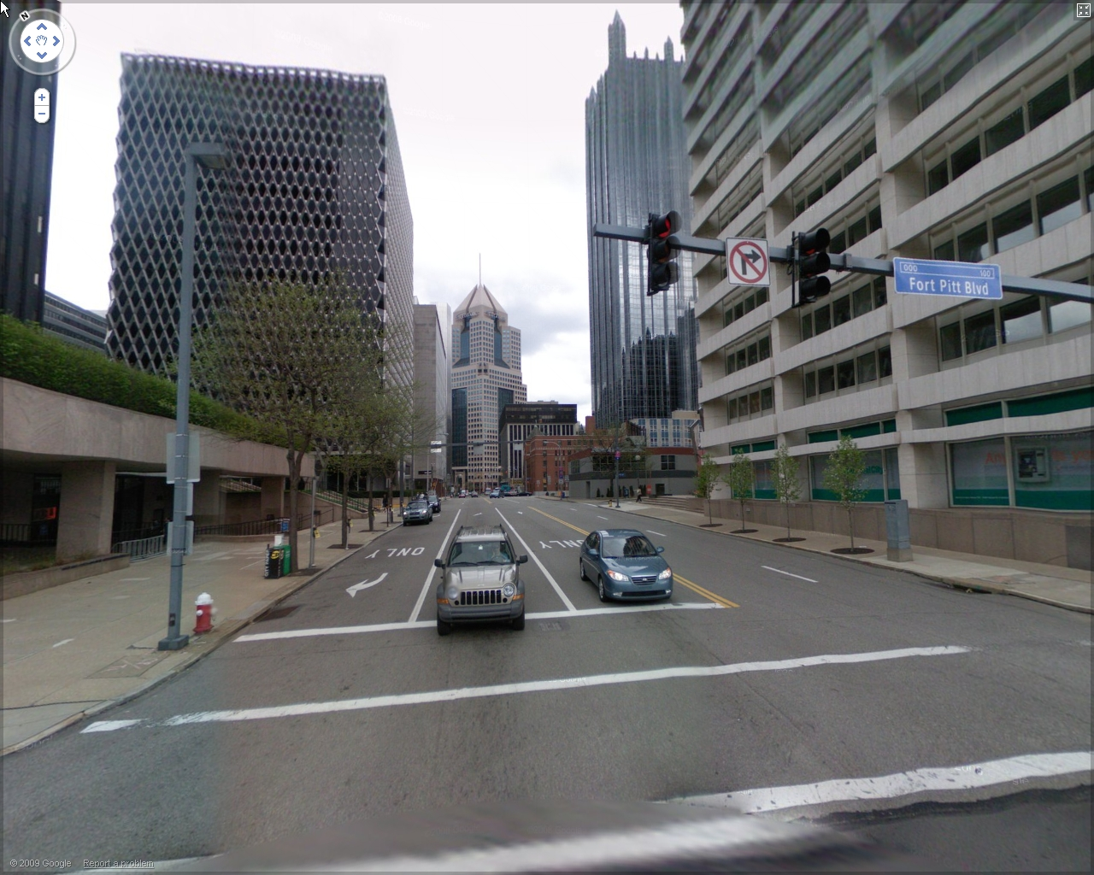
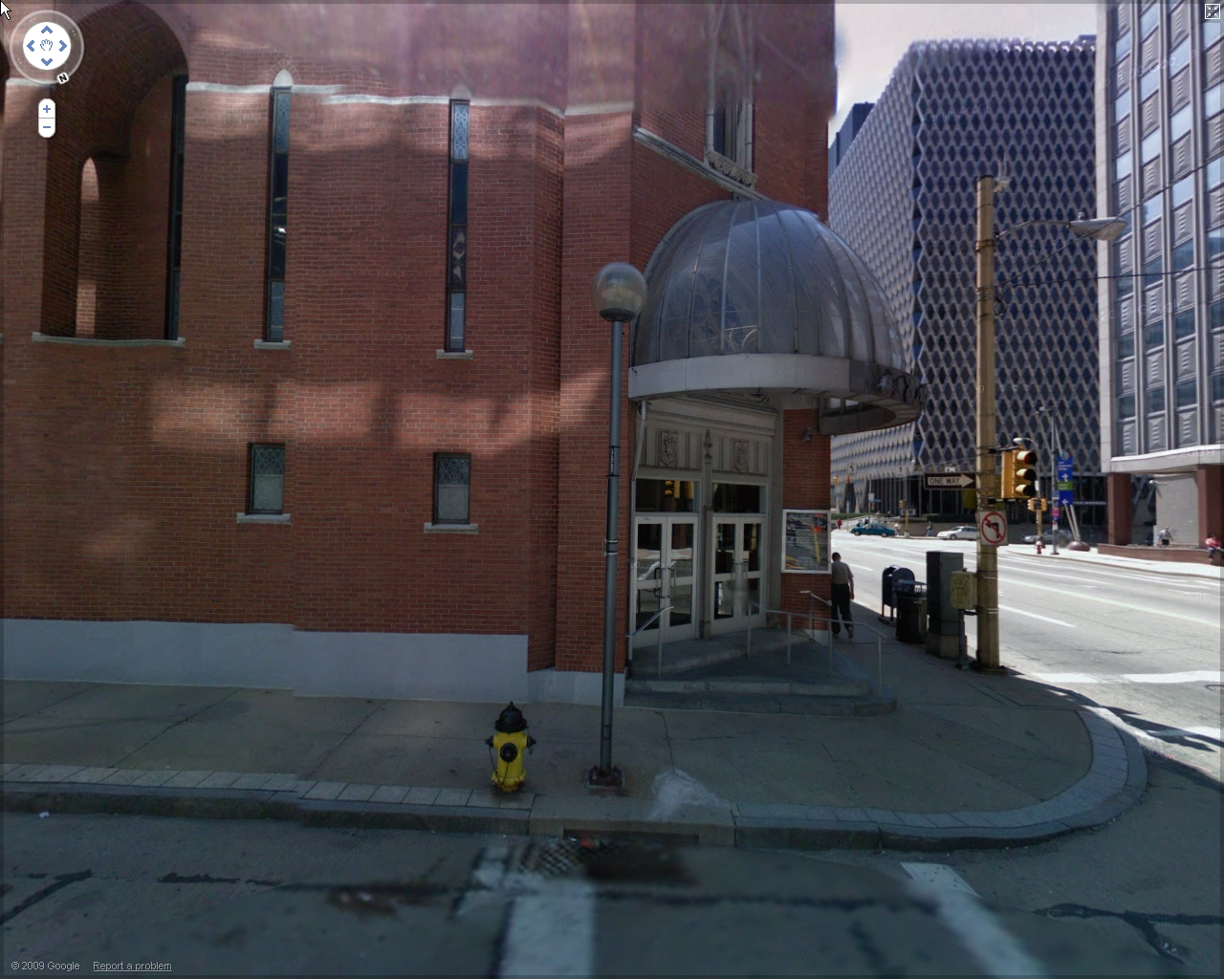
Sample Matches
1
3
71 m
103 m
2
4
Query Image
151 m
67 m

Slide 34
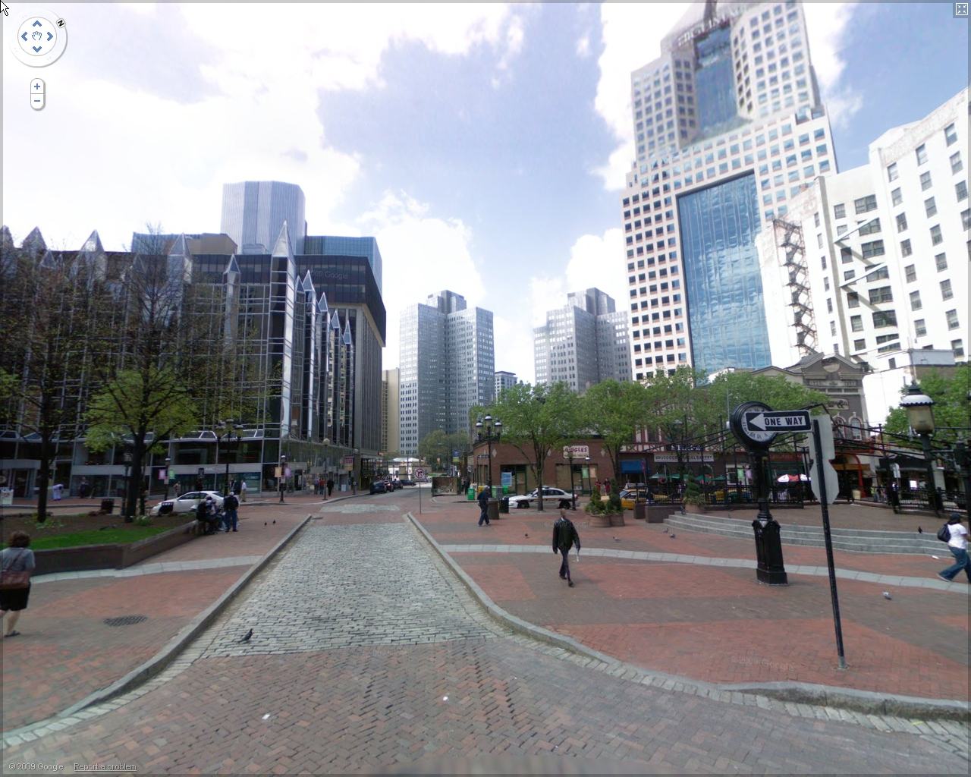
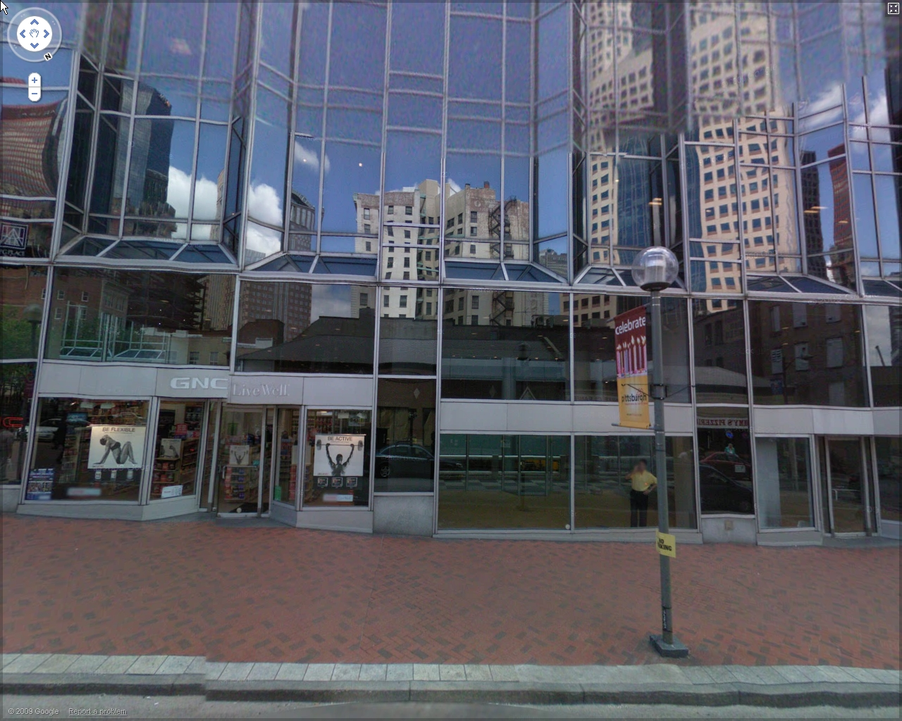
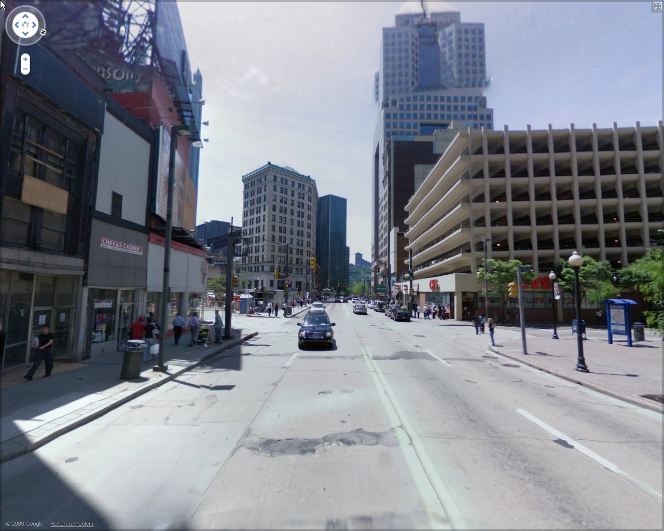
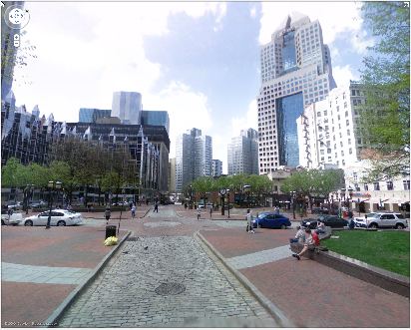
Sample Matches
1
3
10 m
45 m
Query Image
2
4
181 m
28 m

Slide 35
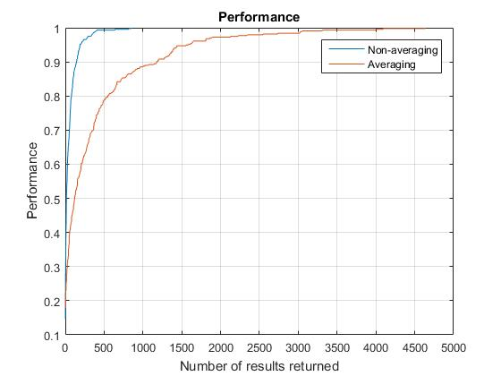

Results
Success: Vicinity of 80 m
Vocabulary tree: $8^{6}$
N=8
Average query time: 4.3 s
Non-averaging
15% at first result
42% at first 10 results
85% at first 100 results
Averaging
17% at first result
23% at first 10 result
46% at first 100 result

Slide 36
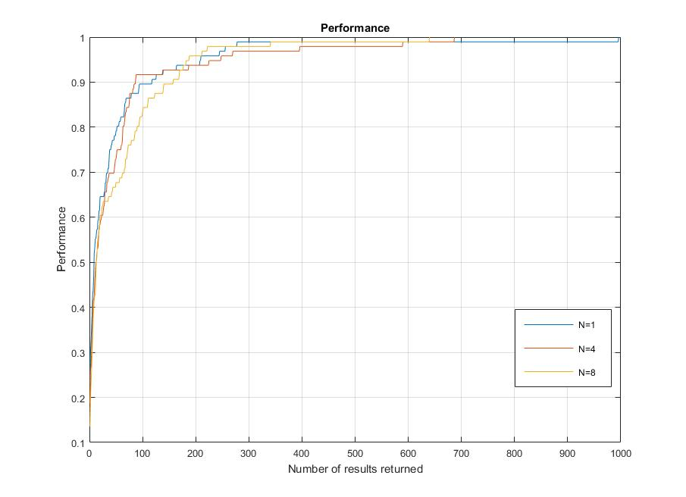
Results
Comparing different N for Greedy N-Best Paths
N=1
Average query time: 1.9 s
22% at first result
53% at first 10 results
90% at first 100 results
N=4
Average query time: 2.2 s
19% at first result
46% at first 10 results
92% at first 100 results
N=8
Average query time: 4.3 s
14% at first result
43% at first 10 results
84% at first 100 results

Slide 37
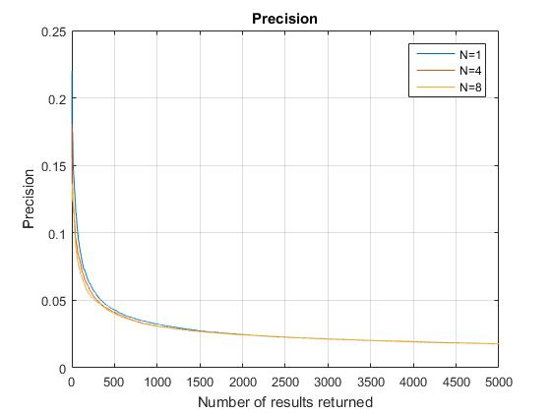
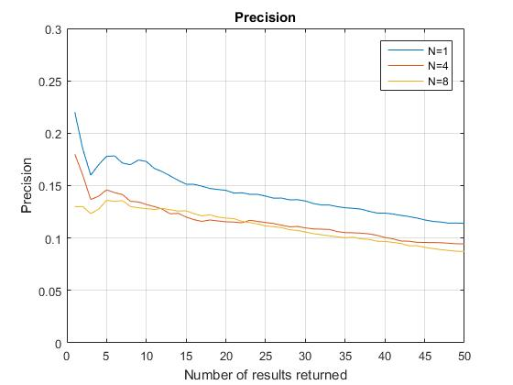
Results
Same plot, zoomed in

Slide 38
Conclusion
Averaging operation didn’t improve performance
Dataset is too sparse
Adding overlapping images of same locations to training dataset
Effective feature selection
Likely to increase performance
Adding new locations to training dataset
Decreases the number of features chosen from each image
Likely to decrease performance

